Slide 1
Machine Learning

Slide 2
Machine Learning Machine Learning (ML) is a branch of Artificial Intelligence (AI) that focuses on building systems capable of learning from data and improving their performance over time without being explicitly programmed with fixed rules. Instead of following step-by-step instructions, these systems identify patterns, relationships, and insights within data and use them to make predictions or decisions.
Key Idea
Traditional programming → Programmer writes rules + inputs → computer produces outputs.
Machine Learning → Programmer provides data + expected outputs (or just data) → computer learns the rules (model) on its own.
Applications
Email spam detection
Speech and image recognition
Medical diagnosis
Recommendation systems (e.g., Netflix, YouTube, Amazon) and so on.

Slide 3
Types of Machine Learning
Supervised Learning: A type of machine learning where models are trained using labeled data (input-output pairs). Examples: Classification (e.g., spam email detection), Regression (e.g., predicting house prices).
Unsupervised Learning: A type of machine learning where models are trained using unlabeled data (no predefined output). Examples: Clustering (e.g., customer segmentation), Dimensionality reduction.
Semi-Supervised Learning: A hybrid approach that uses a small amount of labeled data together with a large amount of unlabeled data for training. Model is first trained using small set of labeled data. Then the trained model is used to predict the labels(pseudo) of unlabeled data. Then all data are combined and trained the model with huge labeled(true + pseudo) data.

Slide 4
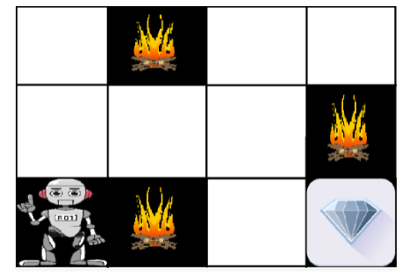
Reinforcement learning: Reinforcement learning is a machine learning training method based on rewarding desired behaviors and/or punishing undesired ones. It helps an agent to maximize its cumulative reward. Example:
The above image shows the robot, diamond, and fire. The goal of the robot is to get the reward that is the diamond and avoid the hurdles that are fire. The robot learns by trying all the possible paths and then choosing the path which gives him the reward with the least hurdles. Each right step will give the robot a reward and each wrong step will subtract the reward of the robot. The total reward will be calculated when it reaches the final reward that is the diamond.

Slide 5
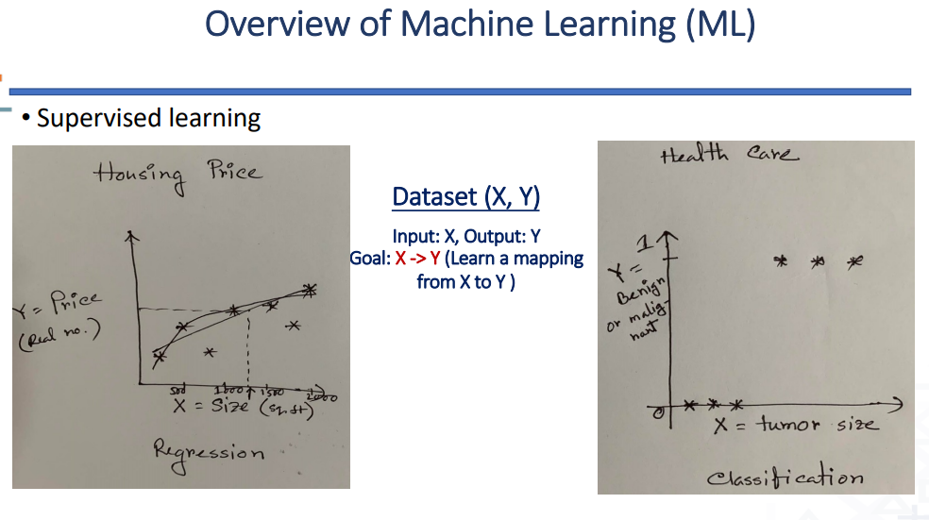

Slide 6
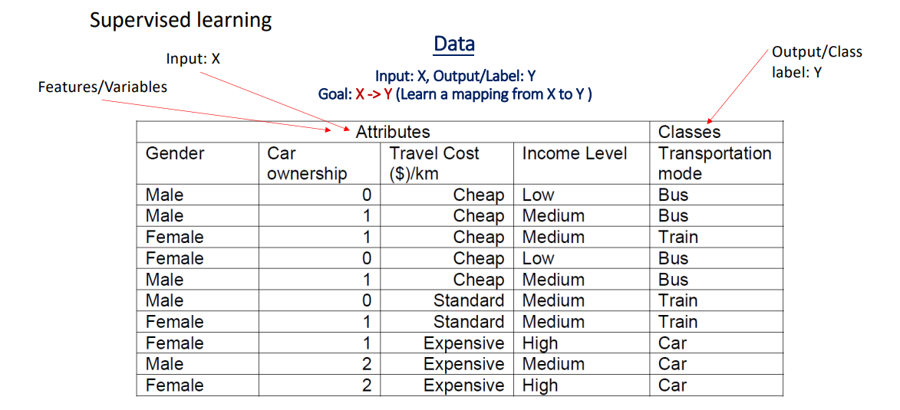
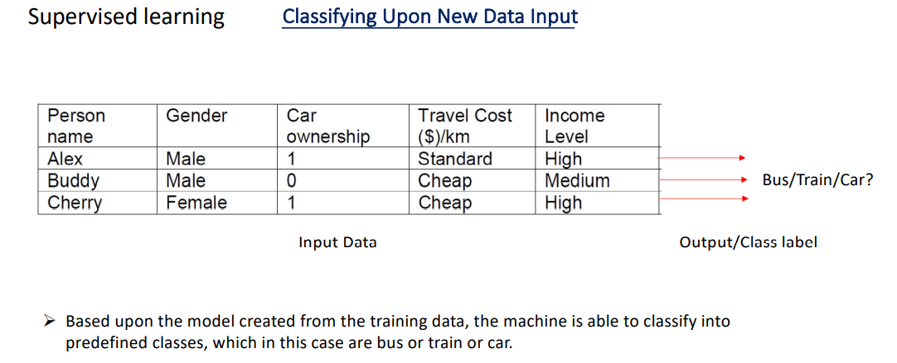

Slide 7
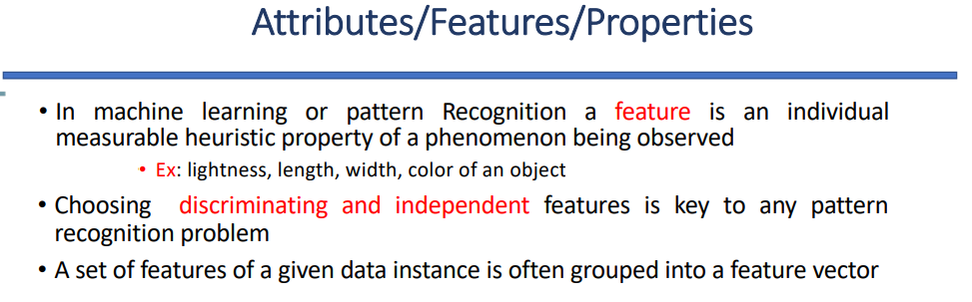
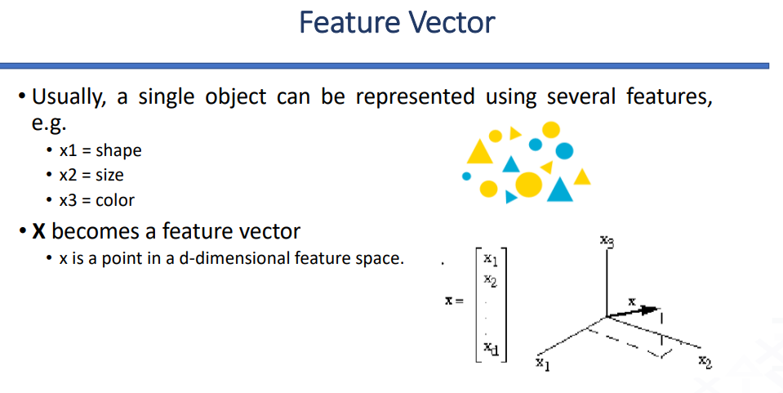

Slide 8
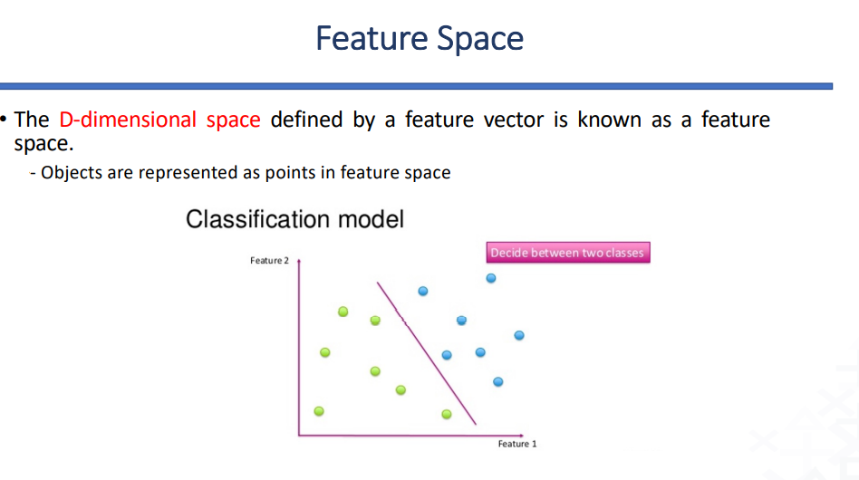

Slide 9
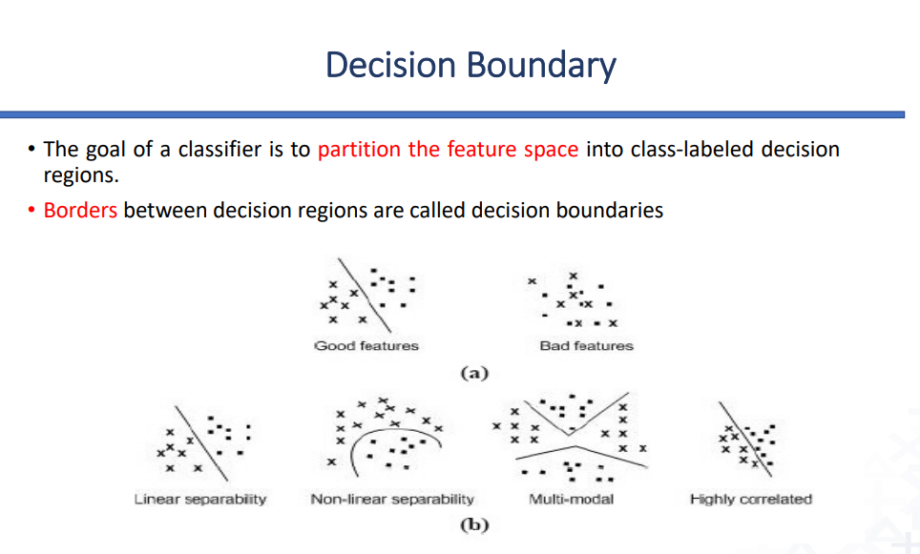

Slide 10
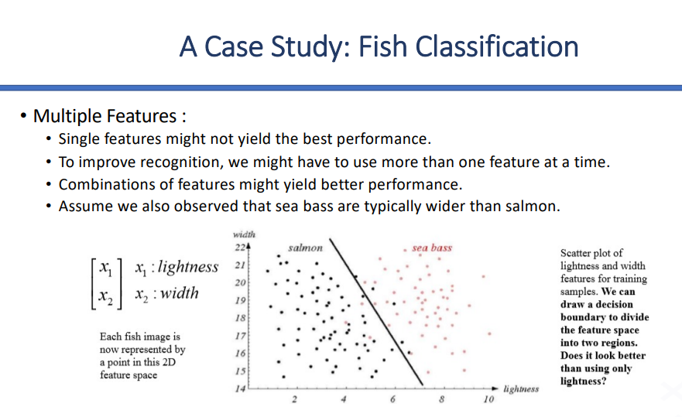

Slide 11
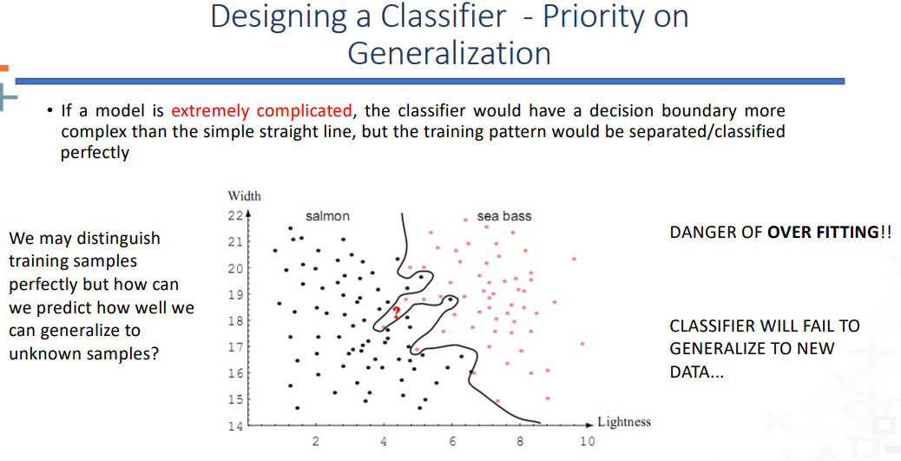

Slide 12
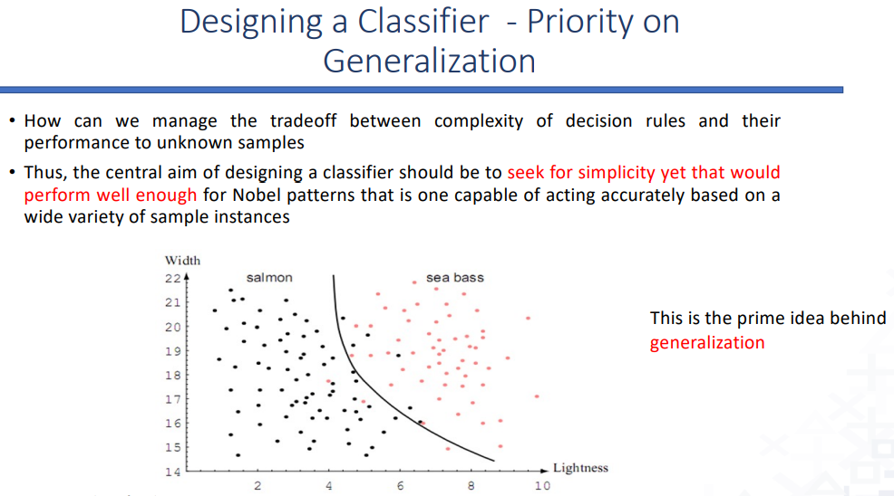

Slide 13
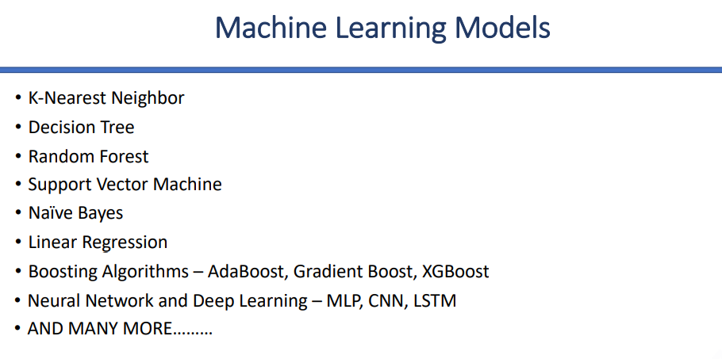
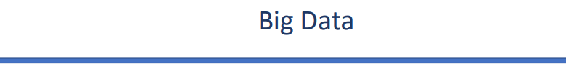
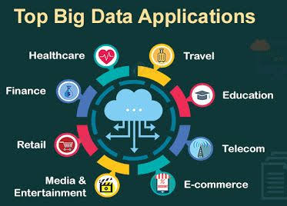
Big Data is a collection of data that is huge in volume, yet growing exponentially with time.

Slide 14
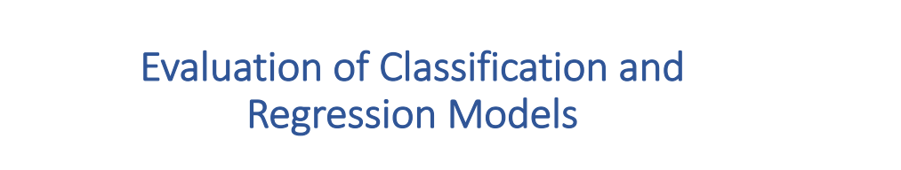

Slide 15
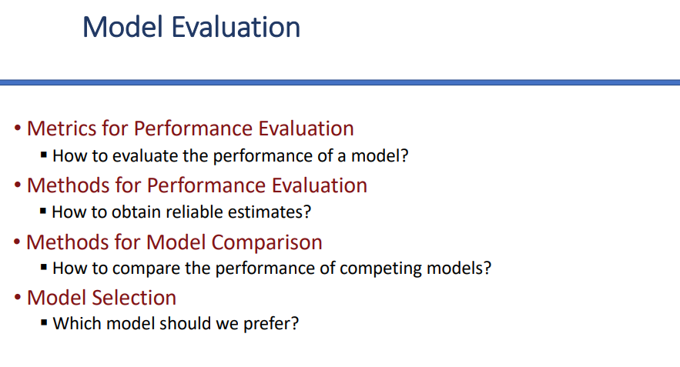
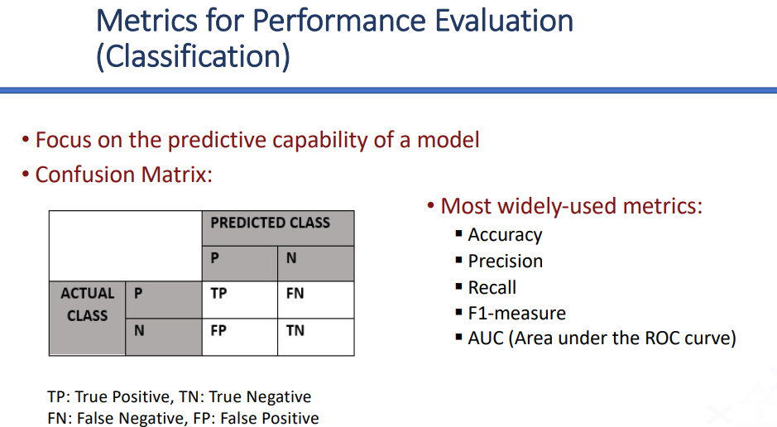

Slide 16
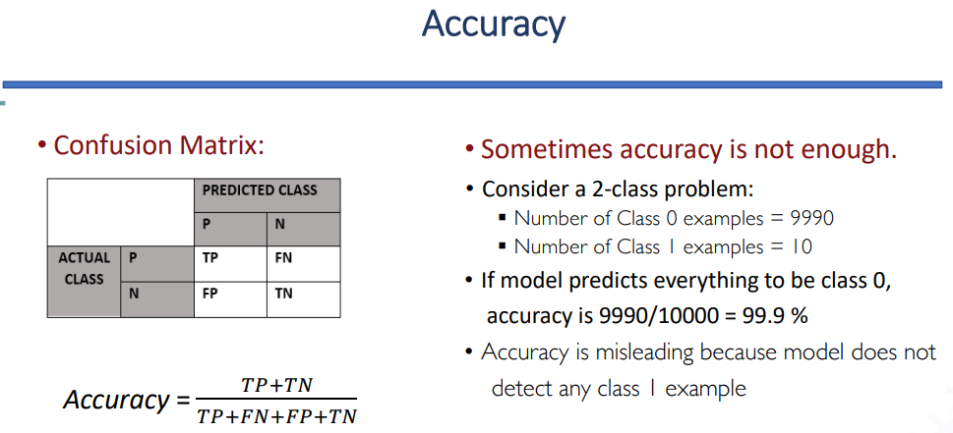


Slide 17
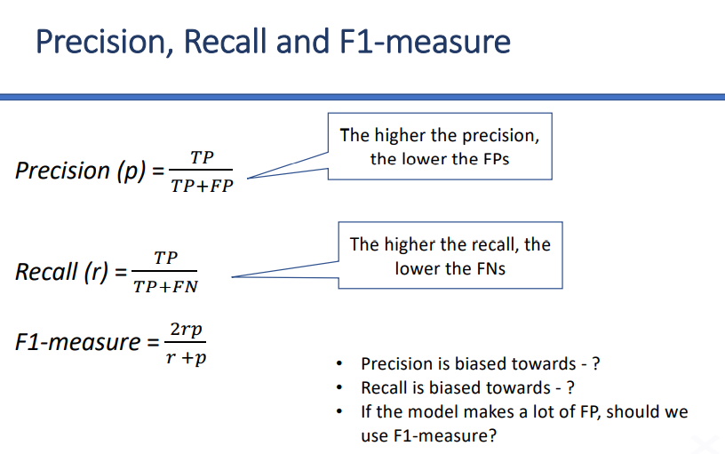
Precision is biased toward false positives (FP).
High precision = very few false positives.
If your model predicts “positive,” you can trust it more.
Example: In spam detection → high precision means very few legitimate emails are wrongly flagged as spam.
Recall is biased toward false negatives (FN).
High recall = very few false negatives.
If something is positive, the model rarely misses it.
Example: In disease detection → high recall means you catch most sick patients, even if you sometimes wrongly classify healthy people.
If the model makes a lot of false positives, using F1-score can be useful in evaluating its performance. F1-score combines both precision and recall into a single metric, providing a balanced measure of the model's accuracy that accounts for both false positives and false negatives.

Slide 18
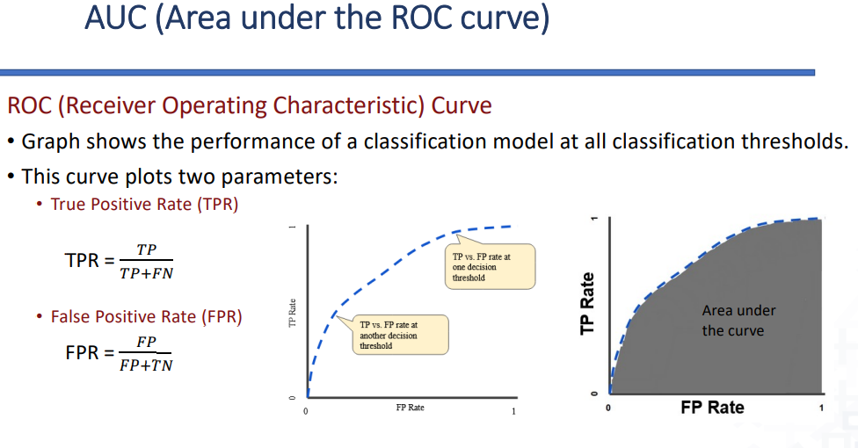

Slide 19
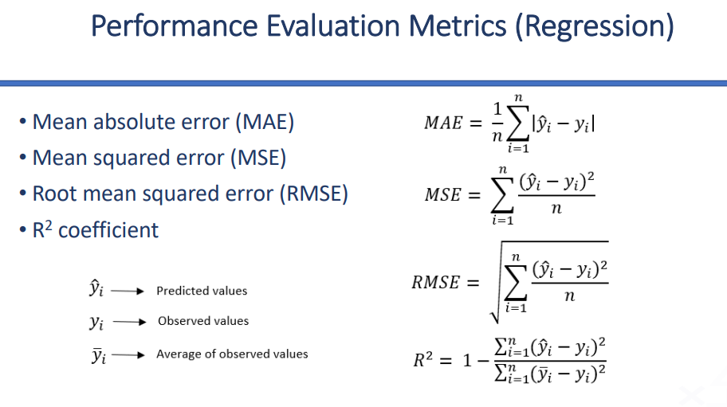

Slide 20
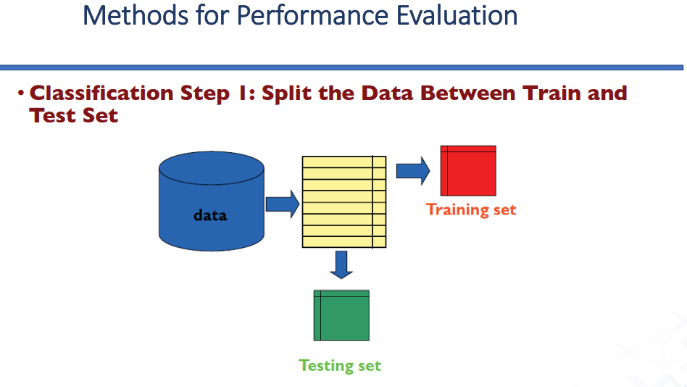
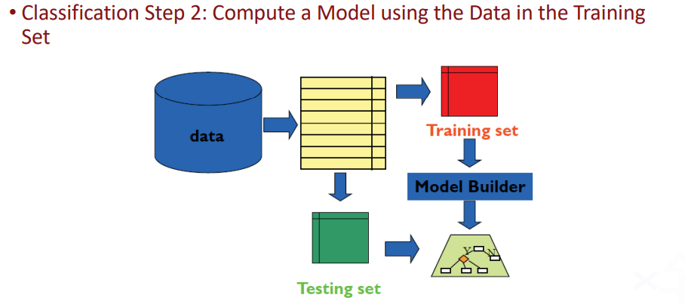

Slide 21
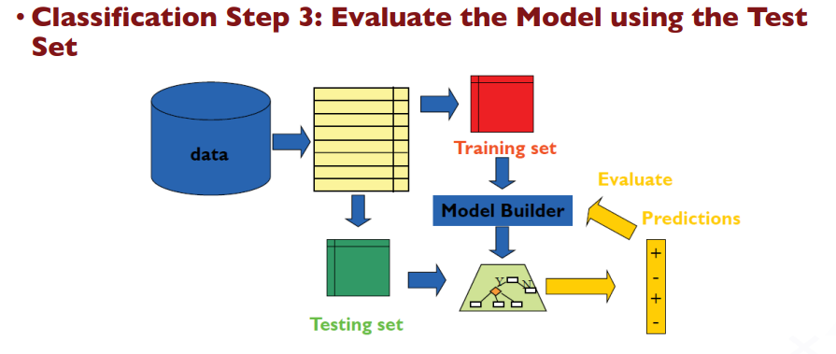

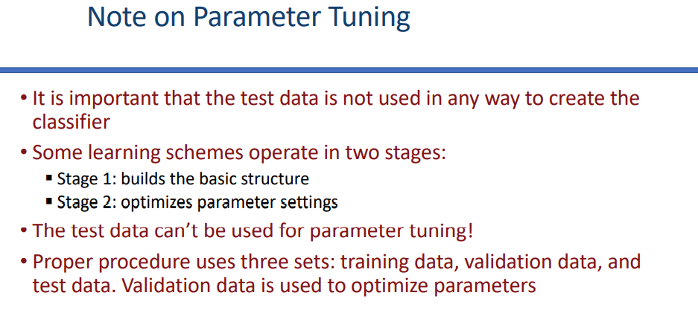

Slide 22
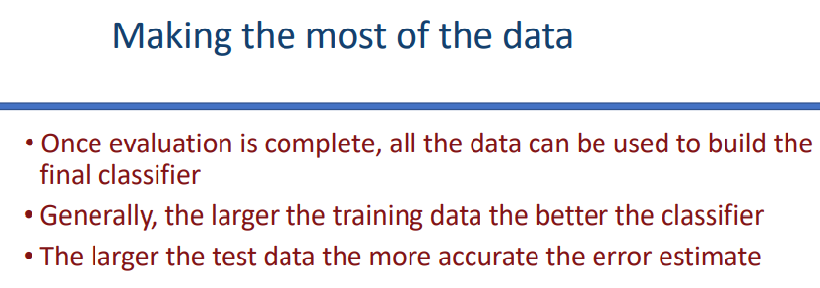
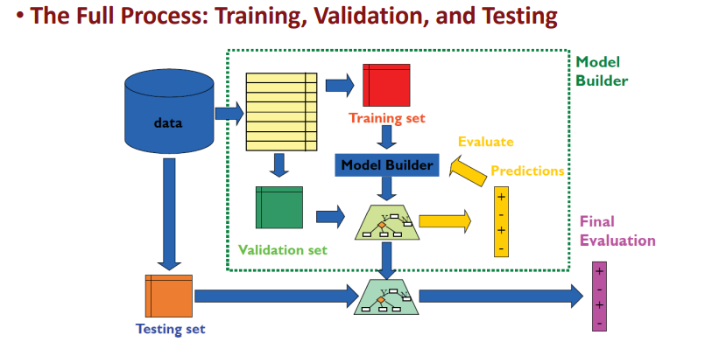

Slide 23
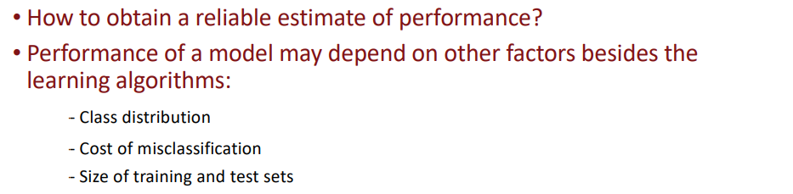
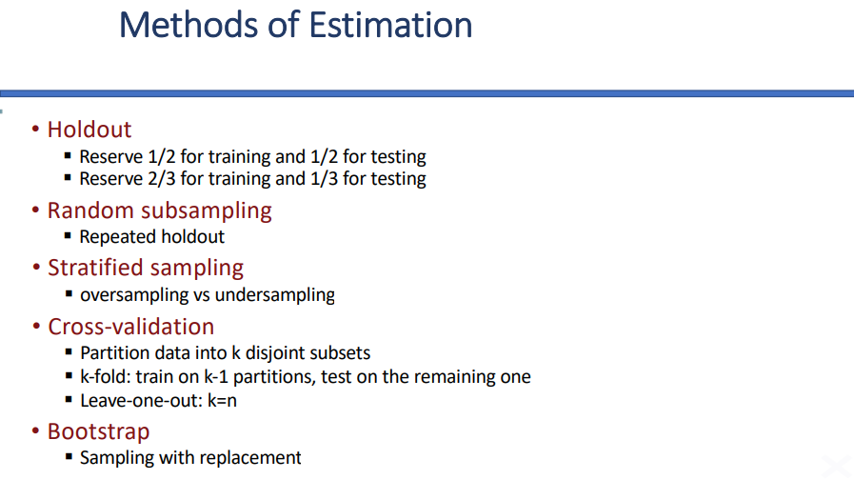

Slide 24
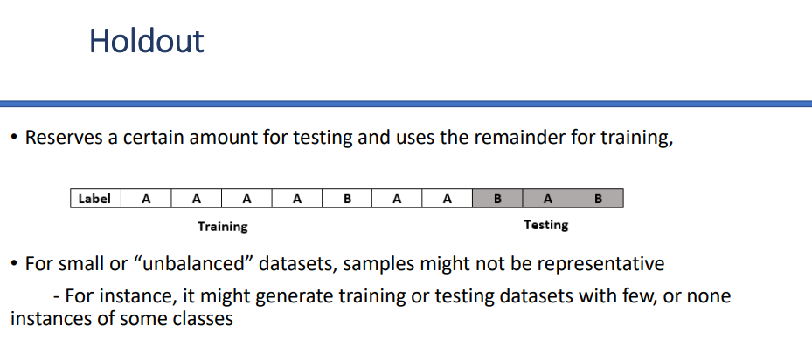
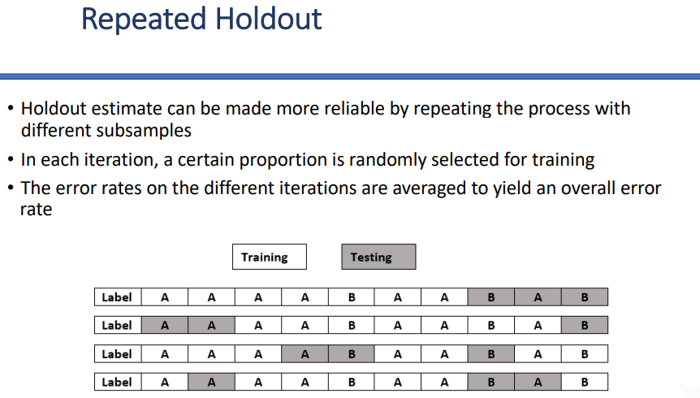

Slide 25
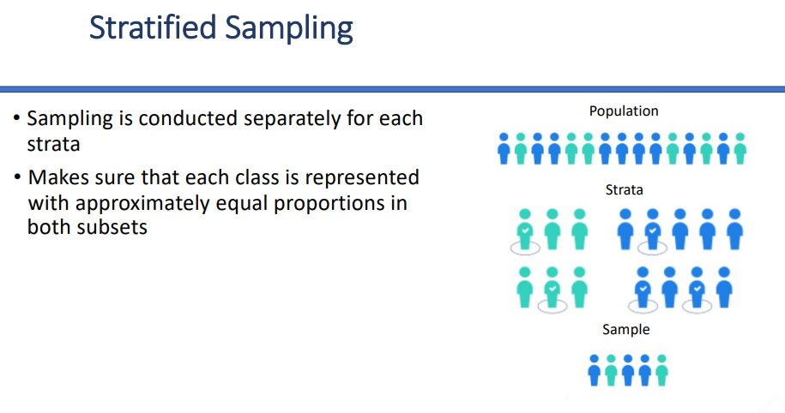

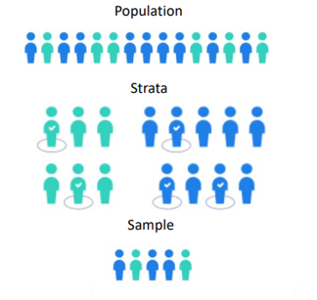
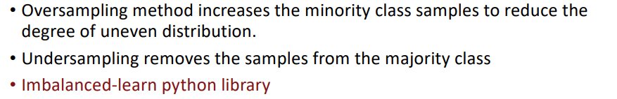

Slide 26
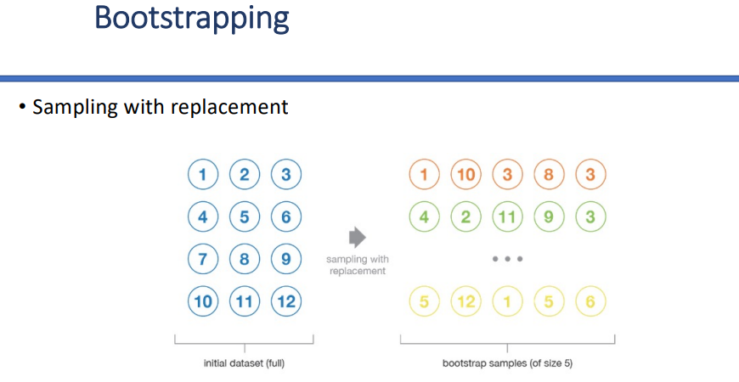

Slide 27
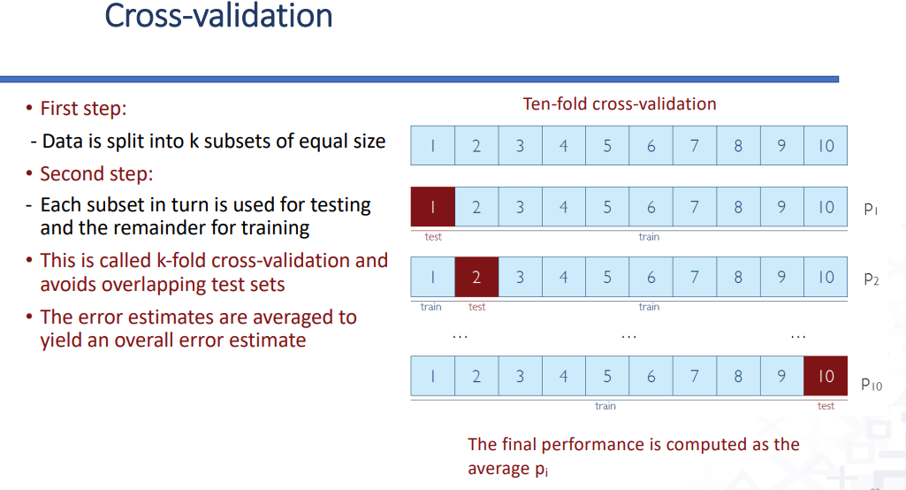

Slide 28
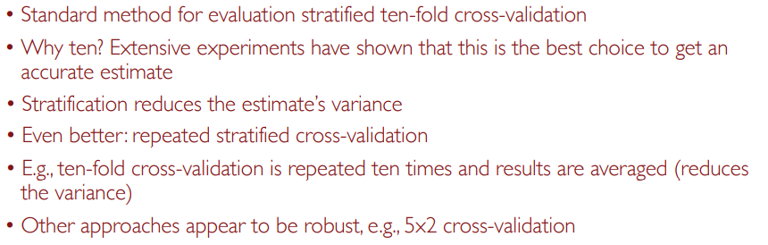
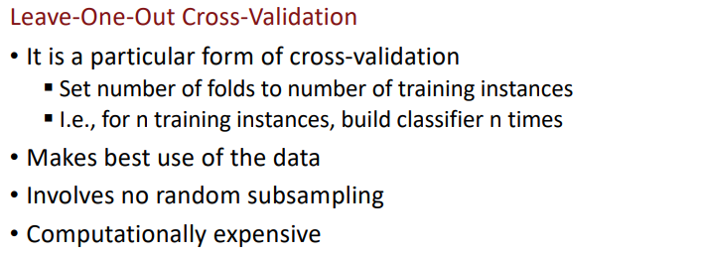

Slide 29
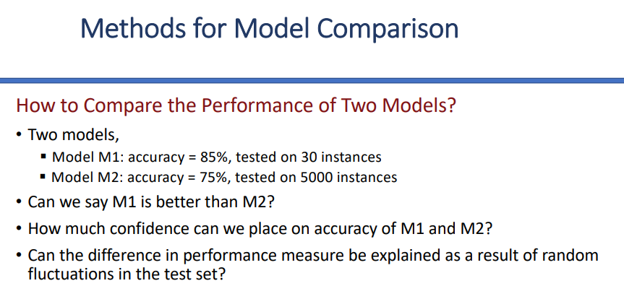
Typical approach:
Use 10-fold cross-validation to get stable performance estimates for each model.
Then, apply a Student’s t-test to check if the difference in their mean performances is statistically significant.
Bottom Line
M1 looks better (85% vs. 75%), but since it’s tested on only 30 cases, we cannot trust it yet.
We should use cross-validation + statistical significance test (t-test) to decide which model is actually better.

Slide 30
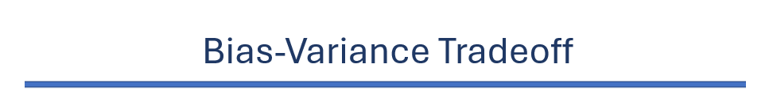
Bias: Error from wrong assumptions in the model.
High bias → model is too simple, underfits (misses important patterns).
Variance: Error from sensitivity to training data.
High variance → model is too complex, overfits (captures noise).
Bias–Variance Tradeoff: We want a balance- not too simple (high bias), not too complex (high variance).

Slide 31
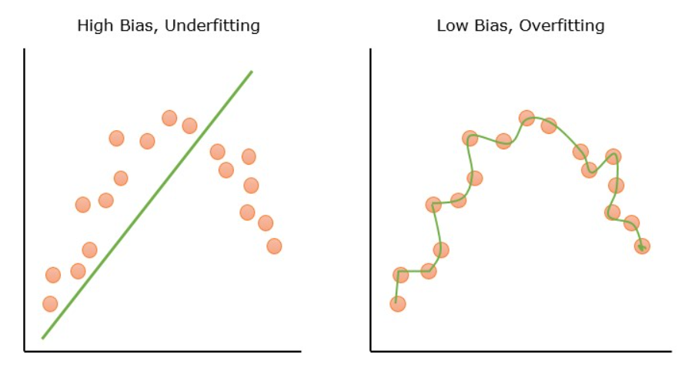

Slide 32
